Slide 1

2

Slide 2

JSON Fundamentals
What is react?
Installation of react.
Important extensions in VScode.
Creating a React App
React DOM renders
React JSX
React Components

Slide 3

JSON Fundamentals :
JSON stands for JavaScript Object Notation
JSON is a text format for storing and transporting data
JSON is "self-describing" and easy to understand.
Data is in name/value pairs
Data is separated by commas
Curly braces hold objects
Square brackets hold arrays
A name/value pair consists of a field name (in double quotes), followed by a colon, followed by a value:
let student = {{"name":"John",
“age” : 16}, {“name”:Priya, “age”: [16,20],{}}}

Slide 4
JSON Datatypes:
a string
a number
an object (JSON object)
an array
a boolean
null

Slide 5
What is React?
React is a JavaScript library for building user interfaces.
React is used to build single-page applications.
React allows us to create reusable UI components.

Slide 6
What is React?
React is a JavaScript library for building user interfaces.
React is used to build single-page applications.
React allows us to create reusable UI components.

Slide 7
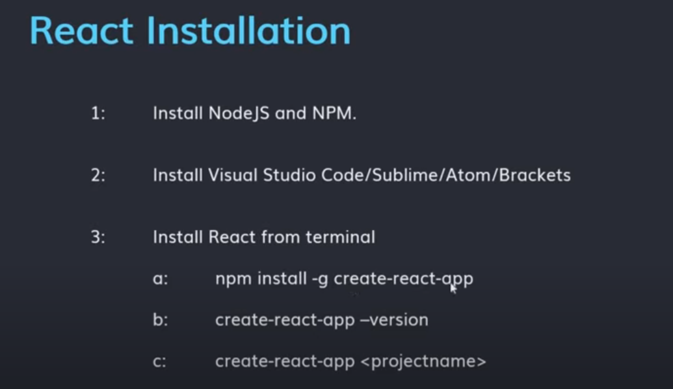
Installing React:

Slide 8
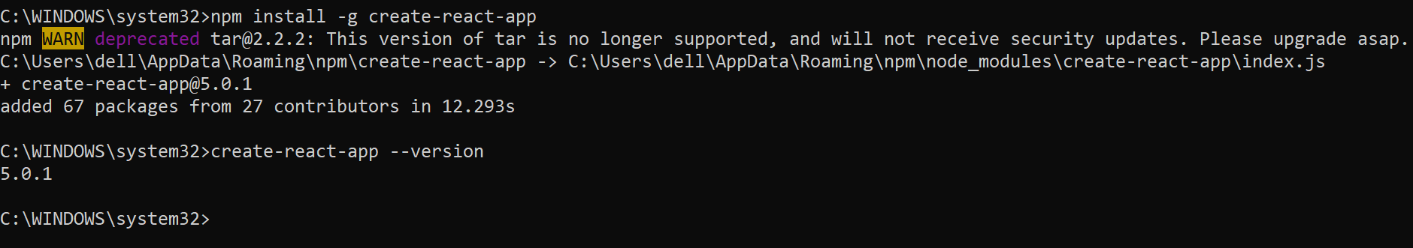
Installing React:

Slide 9
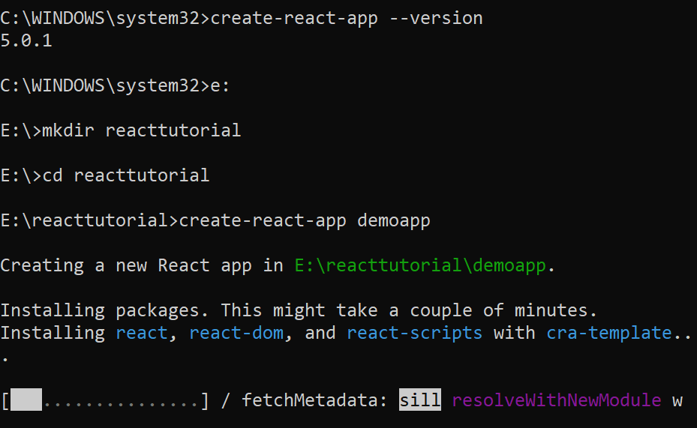
Installing React:
To Verify version of React :

Slide 10
Installing React:
To Verify version of React :

Slide 11
Important VS Extensions :
JavaScript (ES6) code snippets
Babel JavaScript
vscode icons

Slide 12
Creating New React App:
npx create-react-app my-app
cd my-app
npm start

Slide 13
React.createElement()
import React from 'react';
import ReactDOM from 'react-dom';
let demo = React.createElement(
"h1", { style: { color: "green" } }, "Welcome to our page"
)
ReactDOM.render(
demo,
document.getElementById('root')
);

Slide 14
React.createRoot()
const root = ReactDOM.createRoot(
document.getElementById('root2')
);
const element = <h1>Hello, world</h1>;
root.render(element);

Slide 15

JSON Fundamentals
What is react?
Installation of react.
Important extensions in VScode.
Creating a React App
React DOM renders
React JSX
React Components
QnA

Slide 16


